Slide 1
Digital Design & Computer Arch. Lecture 21a: Memory Organization and Memory Technology
Prof. Onur Mutlu
ETH Zürich
Spring 2020
14 May 2020

Slide 2
Readings for This Lecture and Next
Memory Hierarchy and Caches
Required
H&H Chapters 8.1-8.3
Refresh: P&P Chapter 3.5
Recommended
An early cache paper by Maurice Wilkes
Wilkes, “Slave Memories and Dynamic Storage Allocation,” IEEE Trans. On Electronic Computers, 1965.

Slide 3
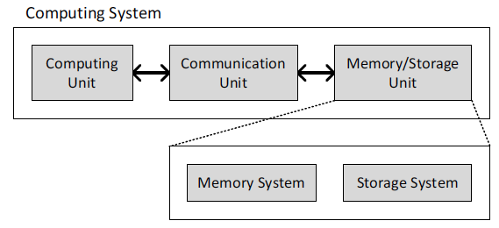
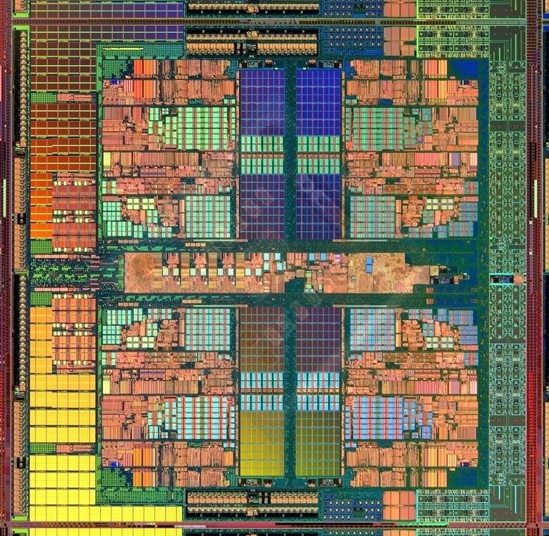
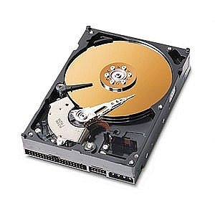
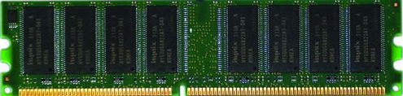
A Computing System
Three key components
Computation
Communication
Storage/memory
Burks, Goldstein, von Neumann, “Preliminary discussion of the
logical design of an electronic computing instrument,” 1946.
Image source: https://lbsitbytes2010.wordpress.com/2013/03/29/john-von-neumann-roll-no-15/

Slide 4
What is A Computer?
We will cover all three components
Processing
Memory
(program
and data)
I/O
control
(sequencing)
datapath

Slide 5
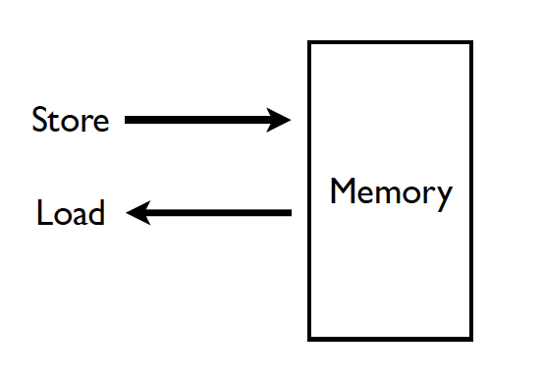
Memory (Programmer’s View)

Slide 6
Abstraction: Virtual vs. Physical Memory
Programmer sees virtual memory
Can assume the memory is “infinite”
Reality: Physical memory size is much smaller than what the programmer assumes
The system (system software + hardware, cooperatively) maps virtual memory addresses to physical memory
The system automatically manages the physical memory space transparently to the programmer
+ Programmer does not need to know the physical size of memory nor manage it → A small physical memory can appear as a huge one to the programmer → Life is easier for the programmer
-- More complex system software and architecture
A classic example of the programmer/(micro)architect tradeoff

Slide 7
(Physical) Memory System
You need a larger level of storage to manage a small amount of physical memory automatically
→ Physical memory has a backing store: disk
We will first start with the physical memory system
For now, ignore the virtual→physical indirection
We will get back to it later, if time permits…

Slide 8
Idealism
Pipeline
(Instruction
execution)
Instruction
Supply
Data
Supply
- Zero latency access
- Infinite capacity
- Zero cost
- Perfect control flow
No pipeline stalls
Perfect data flow
(reg/memory dependencies)
Zero-cycle interconnect
(operand communication)
Enough functional units
Zero latency compute
Zero latency access
Infinite capacity
- Infinite bandwidth
Zero cost

Slide 9
Quick Overview of Memory Arrays

Slide 10
How Can We Store Data?
Flip-Flops (or Latches)
Very fast, parallel access
Very expensive (one bit costs tens of transistors)
Static RAM (we will describe them in a moment)
Relatively fast, only one data word at a time
Expensive (one bit costs 6 transistors)
Dynamic RAM (we will describe them a bit later)
Slower, one data word at a time, reading destroys content (refresh), needs special process for manufacturing
Cheap (one bit costs only one transistor plus one capacitor)
Other storage technology (flash memory, hard disk, tape)
Much slower, access takes a long time, non-volatile
Very cheap (no transistors directly involved)

Slide 11
Array Organization of Memories
Goal: Efficiently store large amounts of data
A memory array (stores data)
Address selection logic (selects one row of the array)
Readout circuitry (reads data out)
An M-bit value can be read or written at each unique N-bit address
All values can be accessed, but only M-bits at a time
Access restriction allows more compact organization

Slide 12
Memory Arrays
Two-dimensional array of bit cells
Each bit cell stores one bit
An array with N address bits and M data bits:
2^{N} rows and M columns
Depth: number of rows (number of words)
Width: number of columns (size of word)
Array size: depth × width = 2^{N} × M

Slide 13
Memory Array Example
2² × 3-bit array
Number of words: 4
Word size: 3-bits
For example, the 3-bit word stored at address 10 is 100

Slide 14
Larger and Wider Memory Array Example

Slide 15
Memory Array Organization (I)
Storage nodes in one column connected to one bitline
Address decoder activates only ONE wordline
Content of one line of storage available at output

Slide 16
Memory Array Organization (II)
Storage nodes in one column connected to one bitline
Address decoder activates only ONE wordline
Content of one line of storage available at output
Active wordline
10
1
0
0

Slide 17
How is Access Controlled?
Access transistors configured as switches connect the bit storage to the bitline.
Access controlled by the wordline
DRAM
SRAM

Slide 18
Building Larger Memories
Requires larger memory arrays
Large → slow
How do we make the memory large without making it very slow?
Idea: Divide the memory into smaller arrays and interconnect the arrays to input/output buses
Large memories are hierarchical array structures
DRAM: Channel → Rank → Bank → Subarrays → Mats

Slide 19
General Principle: Interleaving (Banking)
Interleaving (banking)
Problem: a single monolithic large memory array takes long to access and does not enable multiple accesses in parallel
Goal: Reduce the latency of memory array access and enable multiple accesses in parallel
Idea: Divide a large array into multiple banks that can be accessed independently (in the same cycle or in consecutive cycles)
Each bank is smaller than the entire memory storage
Accesses to different banks can be overlapped
A Key Issue: How do you map data to different banks? (i.e., how do you interleave data across banks?)

Slide 20
Memory Technology: DRAM and SRAM

Slide 21
Memory Technology: DRAM
Dynamic random access memory
Capacitor charge state indicates stored value
Whether the capacitor is charged or discharged indicates storage of 1 or 0
1 capacitor
1 access transistor
Capacitor leaks through the RC path
DRAM cell loses charge over time
DRAM cell needs to be refreshed
row enable
_bitline

Slide 22
Memory Technology: SRAM
Static random access memory
Two cross coupled inverters store a single bit
Feedback path enables the stored value to persist in the “cell”
4 transistors for storage
2 transistors for access
row select
bitline
_bitline

Slide 23
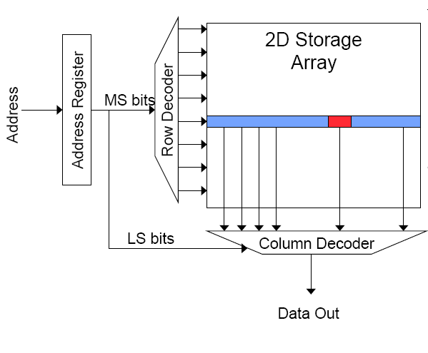
Memory Bank Organization and Operation
Read access sequence:
1. Decode row address & drive word-lines
2. Selected bits drive bit-lines
• Entire row read
3. Amplify row data
4. Decode column address & select subset of row
• Send to output
5. Precharge bit-lines
• For next access

Slide 24
SRAM (Static Random Access Memory)
Read Sequence
1. address decode
2. drive row select
3. selected bit-cells drive bitlines
(entire row is read together)
4. differential sensing and column select
(data is ready)
5. precharge all bitlines
(for next read or write)
Access latency dominated by steps 2 and 3
Cycling time dominated by steps 2, 3 and 5
step 2 proportional to 2^{m}
step 3 and 5 proportional to 2^{n}
row select
bitline
_bitline
bit-cell array
2^{n} row x 2^{m}-col
(n≈m to minimize
overall latency)
n+m
n
2^{n}
m
2^{m} diff pairs
sense amp and mux
1

Slide 25
DRAM (Dynamic Random Access Memory)
row enable
Bits stored as charges on node capacitance (non-restorative)
bit cell loses charge when read
bit cell loses charge over time
Read Sequence
1~3 same as SRAM
4. a “flip-flopping” sense amp amplifies and regenerates the bitline, data bit is mux’ed out
5. precharge all bitlines
Destructive reads
Charge loss over time
Refresh: A DRAM controller must periodically read each row within the allowed refresh time (10s of ms) such that charge is restored
_bitline
RAS
bit-cell array
2^{n} row x 2^{m}-col
(n≈m to minimize
overall latency)
n
2^{n}
m
2^{m}
sense amp and mux
1
A DRAM die comprises
of multiple such arrays
CAS

Slide 26
DRAM vs. SRAM
DRAM
Slower access (capacitor)
Higher density (1T 1C cell)
Lower cost
Requires refresh (power, performance, circuitry)
Manufacturing requires putting capacitor and logic together
SRAM
Faster access (no capacitor)
Lower density (6T cell)
Higher cost
No need for refresh
Manufacturing compatible with logic process (no capacitor)

Slide 27
Digital Design & Computer Arch. Lecture 21a: Memory Organization and Memory Technology
Prof. Onur Mutlu
ETH Zürich
Spring 2020
14 May 2020

Slide 28
We did not cover the following slides in lecture. These are for your preparation for the next lecture.

Slide 29
The Memory Hierarchy

Slide 30
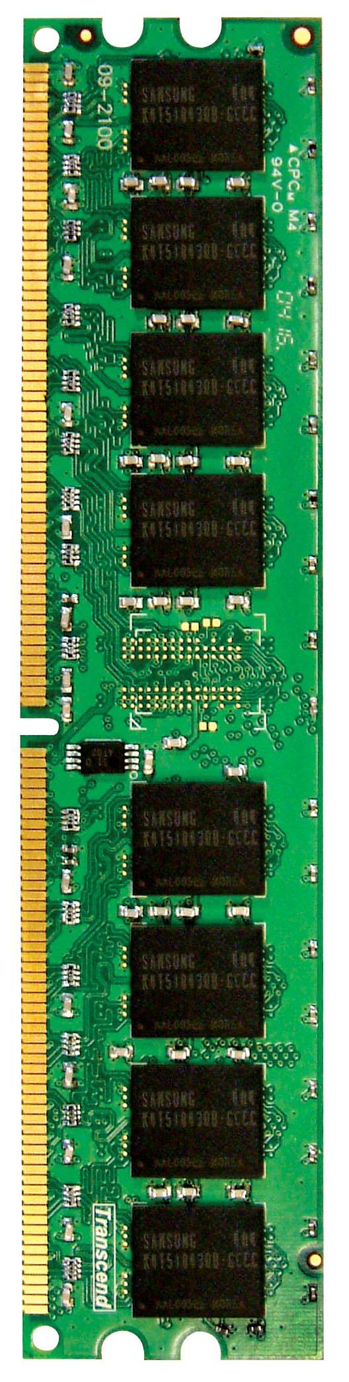
Memory in a Modern System
CORE 0
L2 CACHE 1
CORE 1
L2 CACHE 0
SHARED L3 CACHE
DRAM INTERFACE
DRAM MEMORY CONTROLLER
DRAM BANKS
L2 CACHE 2
CORE 3
CORE 2
L2 CACHE 3

Slide 31
Ideal Memory
Zero access time (latency)
Infinite capacity
Zero cost
Infinite bandwidth (to support multiple accesses in parallel)

Slide 32
The Problem
Ideal memory’s requirements oppose each other
Bigger is slower
Bigger → Takes longer to determine the location
Faster is more expensive
Memory technology: SRAM vs. DRAM vs. Disk vs. Tape
Higher bandwidth is more expensive
Need more banks, more ports, higher frequency, or faster technology

Slide 33
The Problem
Bigger is slower
SRAM, 512 Bytes, sub-nanosec
SRAM, KByte~MByte, ~nanosec
DRAM, Gigabyte, ~50 nanosec
Hard Disk, Terabyte, ~10 millisec
Faster is more expensive (dollars and chip area)
SRAM, < 10$ per Megabyte
DRAM, < 1$ per Megabyte
Hard Disk < 1$ per Gigabyte
These sample values (circa ~2011) scale with time
Other technologies have their place as well
Flash memory (mature), PC-RAM, MRAM, RRAM (not mature yet)

Slide 34
Why Memory Hierarchy?
We want both fast and large
But we cannot achieve both with a single level of memory
Idea: Have multiple levels of storage (progressively bigger and slower as the levels are farther from the processor) and ensure most of the data the processor needs is kept in the fast(er) level(s)

Slide 35
The Memory Hierarchy
move what you use here
fast
small
With good locality of reference, memory appears as fast as
and as large as
faster per byte
cheaper per byte
backup
everything
here
big but slow

Slide 36
Memory Hierarchy
Fundamental tradeoff
Fast memory: small
Large memory: slow
Idea: Memory hierarchy
Latency, cost, size,
bandwidth
Hard Disk
Main
Memory
(DRAM)
CPU
Cache
RF

Slide 37
Locality
One’s recent past is a very good predictor of his/her near future.
Temporal Locality: If you just did something, it is very likely that you will do the same thing again soon
since you are here today, there is a good chance you will be here again and again regularly
Spatial Locality: If you did something, it is very likely you will do something similar/related (in space)
every time I find you in this room, you are probably sitting close to the same people

Slide 38
Memory Locality
A “typical” program has a lot of locality in memory references
typical programs are composed of “loops”
Temporal: A program tends to reference the same memory location many times and all within a small window of time
Spatial: A program tends to reference a cluster of memory locations at a time
most notable examples:
1. instruction memory references
2. array/data structure references

Slide 39
Caching Basics: Exploit Temporal Locality
Idea: Store recently accessed data in automatically managed fast memory (called cache)
Anticipation: the data will be accessed again soon
Temporal locality principle
Recently accessed data will be again accessed in the near future
This is what Maurice Wilkes had in mind:
Wilkes, “Slave Memories and Dynamic Storage Allocation,” IEEE Trans. On Electronic Computers, 1965.
“The use is discussed of a fast core memory of, say 32000 words as a slave to a slower core memory of, say, one million words in such a way that in practical cases the effective access time is nearer that of the fast memory than that of the slow memory.”

Slide 40
Caching Basics: Exploit Spatial Locality
Idea: Store addresses adjacent to the recently accessed one in automatically managed fast memory
Logically divide memory into equal size blocks
Fetch to cache the accessed block in its entirety
Anticipation: nearby data will be accessed soon
Spatial locality principle
Nearby data in memory will be accessed in the near future
E.g., sequential instruction access, array traversal
This is what IBM 360/85 implemented
16 Kbyte cache with 64 byte blocks
Liptay, “Structural aspects of the System/360 Model 85 II: the cache,” IBM Systems Journal, 1968.

Slide 41
The Bookshelf Analogy
Book in your hand
Desk
Bookshelf
Boxes at home
Boxes in storage
Recently-used books tend to stay on desk
Comp Arch books, books for classes you are currently taking
Until the desk gets full
Adjacent books in the shelf needed around the same time
If I have organized/categorized my books well in the shelf

Slide 42
Caching in a Pipelined Design
The cache needs to be tightly integrated into the pipeline
Ideally, access in 1-cycle so that load-dependent operations do not stall
High frequency pipeline → Cannot make the cache large
But, we want a large cache AND a pipelined design
Idea: Cache hierarchy
Main
Memory
(DRAM)
Level 2
Cache
CPU
Level1
Cache
RF

Slide 43
A Note on Manual vs. Automatic Management
Manual: Programmer manages data movement across levels
-- too painful for programmers on substantial programs
“core” vs “drum” memory in the 50’s
still done in some embedded processors (on-chip scratch pad SRAM in lieu of a cache) and GPUs (called “shared memory”)
Automatic: Hardware manages data movement across levels, transparently to the programmer
++ programmer’s life is easier
the average programmer doesn’t need to know about it
You don’t need to know how big the cache is and how it works to write a “correct” program! (What if you want a “fast” program?)

Slide 44
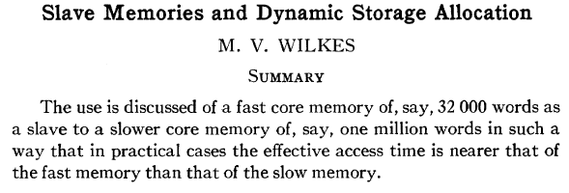
Automatic Management in Memory Hierarchy
Wilkes, “Slave Memories and Dynamic Storage Allocation,” IEEE Trans. On Electronic Computers, 1965.
“By a slave memory I mean one which automatically accumulates to itself words that come from a slower main memory, and keeps them available for subsequent use without it being necessary for the penalty of main memory access to be incurred again.”

Slide 45
Historical Aside: Other Cache Papers
Fotheringham, “Dynamic Storage Allocation in the Atlas Computer, Including an Automatic Use of a Backing Store,” CACM 1961.
http://dl.acm.org/citation.cfm?id=366800
Bloom, Cohen, Porter, “Considerations in the Design of a Computer with High Logic-to-Memory Speed Ratio,” AIEE Gigacycle Computing Systems Winter Meeting, Jan. 1962.

Slide 46
A Modern Memory Hierarchy
Register File
32 words, sub-nsec
L1 cache
~32 KB, ~nsec
L2 cache
512 KB ~ 1MB, many nsec
L3 cache,
.....
Main memory (DRAM),
GB, ~100 nsec
Swap Disk
100 GB, ~10 msec
manual/compiler
register spilling
Memory
Abstraction
Automatic
HW cache
management
automatic
demand
paging

Slide 47
Hierarchical Latency Analysis
For a given memory hierarchy level i it has a technology-intrinsic access time of t_{i,} The perceived access time T_{i} is longer than t_{i}
Except for the outer-most hierarchy, when looking for a given address there is
a chance (hit-rate h_{i}) you “hit” and access time is t_{i}
a chance (miss-rate m_{i}) you “miss” and access time t_{i} +T_{i+1}
h_{i} + m_{i} = 1
Thus
T_{i} = h_{i}·t_{i} + m_{i}·(t_{i} + T_{i+1})
T_{i} = t_{i} + m_{i} ·T_{i+1}
h_{i} and m_{i} are defined to be the hit-rate and miss-rate of just the references that missed at L_{i-1}

Slide 48
Hierarchy Design Considerations
Recursive latency equation
T_{i} = t_{i} + m_{i} ·T_{i+1}
The goal: achieve desired T₁ within allowed cost
T_{i} ≈ t_{i} is desirable
Keep m_{i} low
increasing capacity C_{i} lowers m_{i}, but beware of increasing t_{i}
lower m_{i} by smarter management (replacement::anticipate what you don’t need, prefetching::anticipate what you will need)
Keep T_{i+1} low
faster lower hierarchies, but beware of increasing cost
introduce intermediate hierarchies as a compromise

Slide 49
Intel Pentium 4 Example
90nm P4, 3.6 GHz
L1 D-cache
C₁ = 16K
t₁ = 4 cyc int / 9 cycle fp
L2 D-cache
C₂ =1024 KB
t₂ = 18 cyc int / 18 cyc fp
Main memory
t₃ = ~ 50ns or 180 cyc
Notice
best case latency is not 1
worst case access latencies are into 500+ cycles
if m₁=0.1, m₂=0.1
T₁=7.6, T₂=36
if m₁=0.01, m₂=0.01
T₁=4.2, T₂=19.8
if m₁=0.05, m₂=0.01
T₁=5.00, T₂=19.8
if m₁=0.01, m₂=0.50
T₁=5.08, T₂=108

Slide 50
Cache Basics and Operation

Slide 51
Cache
Generically, any structure that “memoizes” frequently used results to avoid repeating the long-latency operations required to reproduce the results from scratch, e.g. a web cache
Most commonly in the on-die context: an automatically-managed memory hierarchy based on SRAM
memoize in SRAM the most frequently accessed DRAM memory locations to avoid repeatedly paying for the DRAM access latency

Slide 52
Caching Basics
Block (line): Unit of storage in the cache
Memory is logically divided into cache blocks that map to locations in the cache
On a reference:
HIT: If in cache, use cached data instead of accessing memory
MISS: If not in cache, bring block into cache
Maybe have to kick something else out to do it
Some important cache design decisions
Placement: where and how to place/find a block in cache?
Replacement: what data to remove to make room in cache?
Granularity of management: large or small blocks? Subblocks?
Write policy: what do we do about writes?
Instructions/data: do we treat them separately?

Slide 53
Cache Abstraction and Metrics
Cache hit rate = (# hits) / (# hits + # misses) = (# hits) / (# accesses)
Average memory access time (AMAT)
= ( hit-rate * hit-latency ) + ( miss-rate * miss-latency )
Aside: Can reducing AMAT reduce performance?
Address
Tag Store
(is the address
in the cache?
+ bookkeeping)
Data Store
(stores
memory
blocks)
Hit/miss?
Data

Slide 54
A Basic Hardware Cache Design
We will start with a basic hardware cache design
Then, we will examine a multitude of ideas to make it better

Slide 55
Blocks and Addressing the Cache
Memory is logically divided into fixed-size blocks
Each block maps to a location in the cache, determined by the index bits in the address
used to index into the tag and data stores
Cache access:
1) index into the tag and data stores with index bits in address
2) check valid bit in tag store
3) compare tag bits in address with the stored tag in tag store
If a block is in the cache (cache hit), the stored tag should be valid and match the tag of the block
tag
index
byte in block
2b
3 bits
3 bits
8-bit address

Slide 56
Direct-Mapped Cache: Placement and Access
Assume byte-addressable memory: 256 bytes, 8-byte blocks → 32 blocks
Assume cache: 64 bytes, 8 blocks
Direct-mapped: A block can go to only one location
Addresses with same index contend for the same location
Cause conflict misses
tag
index
byte in block
2b
3 bits
3 bits
Tag store
Data store
Address
V
tag
=?
MUX
byte in block
Hit?
Data

Slide 57
Direct-Mapped Caches
Direct-mapped cache: Two blocks in memory that map to the same index in the cache cannot be present in the cache at the same time
One index → one entry
Can lead to 0% hit rate if more than one block accessed in an interleaved manner map to the same index
Assume addresses A and B have the same index bits but different tag bits
A, B, A, B, A, B, A, B, … → conflict in the cache index
All accesses are conflict misses

Slide 58
Set Associativity
Addresses 0 and 8 always conflict in direct mapped cache
Instead of having one column of 8, have 2 columns of 4 blocks
Tag store
Data store
SET
V
tag
V
tag
=?
=?
MUX
Logic
MUX
byte in block
Address
Hit?
tag
index
byte in block
Key idea: Associative memory within the set
+ Accommodates conflicts better (fewer conflict misses)
-- More complex, slower access, larger tag store
3b
2 bits
3 bits

Slide 59
Higher Associativity
4-way
+ Likelihood of conflict misses even lower
-- More tag comparators and wider data mux; larger tags
Tag store
=?
=?
=?
=?
Logic
Hit?
Data store
MUX
MUX
byte in block

Slide 60
Full Associativity
Fully associative cache
A block can be placed in any cache location
Tag store
=?
=?
=?
=?
=?
=?
=?
=?
Logic
Hit?
Data store
MUX
MUX
byte in block

Slide 61
Associativity (and Tradeoffs)
Degree of associativity: How many blocks can map to the same index (or set)?
Higher associativity
++ Higher hit rate
-- Slower cache access time (hit latency and data access latency)
-- More expensive hardware (more comparators)
Diminishing returns from higher
associativity
hit rate
associativity

Slide 62
Issues in Set-Associative Caches
Think of each block in a set having a “priority”
Indicating how important it is to keep the block in the cache
Key issue: How do you determine/adjust block priorities?
There are three key decisions in a set:
Insertion, promotion, eviction (replacement)
Insertion: What happens to priorities on a cache fill?
Where to insert the incoming block, whether or not to insert the block
Promotion: What happens to priorities on a cache hit?
Whether and how to change block priority
Eviction/replacement: What happens to priorities on a cache miss?
Which block to evict and how to adjust priorities

Slide 63
Eviction/Replacement Policy
Which block in the set to replace on a cache miss?
Any invalid block first
If all are valid, consult the replacement policy
Random
FIFO
Least recently used (how to implement?)
Not most recently used
Least frequently used?
Least costly to re-fetch?
Why would memory accesses have different cost?
Hybrid replacement policies
Optimal replacement policy?

Slide 64
Implementing LRU
Idea: Evict the least recently accessed block
Problem: Need to keep track of access ordering of blocks
Question: 2-way set associative cache:
What do you need to implement LRU perfectly?
Question: 4-way set associative cache:
What do you need to implement LRU perfectly?
How many different orderings possible for the 4 blocks in the set?
How many bits needed to encode the LRU order of a block?
What is the logic needed to determine the LRU victim?

Slide 65
Approximations of LRU
Most modern processors do not implement “true LRU” (also called “perfect LRU”) in highly-associative caches
Why?
True LRU is complex
LRU is an approximation to predict locality anyway (i.e., not the best possible cache management policy)
Examples:
Not MRU (not most recently used)
Hierarchical LRU: divide the N-way set into M “groups”, track the MRU group and the MRU way in each group
Victim-NextVictim Replacement: Only keep track of the victim and the next victim

Slide 66
Hierarchical LRU (not MRU)
Divide a set into multiple groups
Keep track of only the MRU group
Keep track of only the MRU block in each group
On replacement, select victim as:
A not-MRU block in one of the not-MRU groups (randomly pick one of such blocks/groups)

Slide 67
Hierarchical LRU (not MRU): Questions
16-way cache
2 8-way groups
What is an access pattern that performs worse than true LRU?
What is an access pattern that performs better than true LRU?

Slide 68
Victim/Next-Victim Policy
Only 2 blocks’ status tracked in each set:
victim (V), next victim (NV)
all other blocks denoted as (O) – Ordinary block
On a cache miss
Replace V
Demote NV to V
Randomly pick an O block as NV
On a cache hit to V
Demote NV to V
Randomly pick an O block as NV
Turn V to O

Slide 69
Victim/Next-Victim Policy (II)
On a cache hit to NV
Randomly pick an O block as NV
Turn NV to O
On a cache hit to O
Do nothing

Slide 70
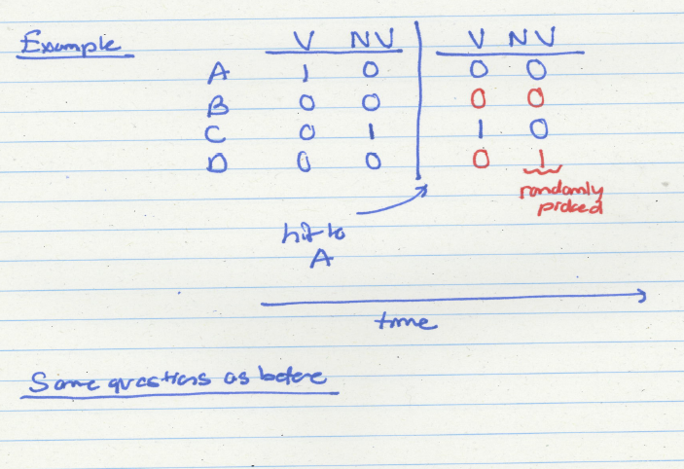
Victim/Next-Victim Example

Slide 71
Cache Replacement Policy: LRU or Random
LRU vs. Random: Which one is better?
Example: 4-way cache, cyclic references to A, B, C, D, E
0% hit rate with LRU policy
Set thrashing: When the “program working set” in a set is larger than set associativity
Random replacement policy is better when thrashing occurs
In practice:
Depends on workload
Average hit rate of LRU and Random are similar
Best of both Worlds: Hybrid of LRU and Random
How to choose between the two? Set sampling
See Qureshi et al., “A Case for MLP-Aware Cache Replacement,“ ISCA 2006.

Slide 72
What Is the Optimal Replacement Policy?
Belady’s OPT
Replace the block that is going to be referenced furthest in the future by the program
Belady, “A study of replacement algorithms for a virtual-storage computer,” IBM Systems Journal, 1966.
How do we implement this? Simulate?
Is this optimal for minimizing miss rate?
Is this optimal for minimizing execution time?
No. Cache miss latency/cost varies from block to block!
Two reasons: Remote vs. local caches and miss overlapping
Qureshi et al. “A Case for MLP-Aware Cache Replacement,“ ISCA 2006.

Slide 73
Reading
Key observation: Some misses more costly than others as their latency is exposed as stall time. Reducing miss rate is not always good for performance. Cache replacement should take into account MLP of misses.
Moinuddin K. Qureshi, Daniel N. Lynch, Onur Mutlu, and Yale N. Patt, "A Case for MLP-Aware Cache Replacement" Proceedings of the 33rd International Symposium on Computer Architecture (ISCA), pages 167-177, Boston, MA, June 2006. Slides (ppt)

